Slide 1
Employee Data Analysis using Excel
STUDENT NAME: Nancy.V
REGISTER NO: 312208973
DEPARTMENT: commerce
COLLEGE : chevaliar T Thomas Elizabeth college for women

Slide 2
PROJECT TITLE
Employee Performance Analysis using Excel

Slide 3


AGENDA
Problem Statement
Project Overview
End Users
Our Solution and Proposition
Dataset Description
Modelling Approach
Results and Discussion
Conclusion
3/21/2024 Annual Review

Slide 4

PROBLEM STATEMENT
• identify the specific area of performance that is problematic,
• who, what, when, where, and why or how
• using a handy "business bar" on the right of the screen.
• using array formula and dynamic range name methods
• evidence to support any unbiased claims.
• using array formula and dynamic range name methods

Slide 5

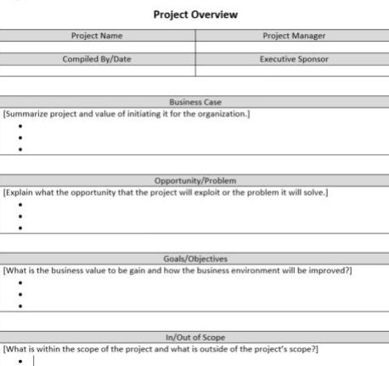
PROJECT OVERVIEW
Employee performance analysis involves evaluating various metrics such as productivity, efficiency, and output quality to assess individual and team performance.
• Employee performance analysis involves evaluating various metrics such as productivity, efficiency, and output quality to assess individual and team performance
• a detailed description of a project's goals and objectives, the steps to achieve these goals, and the expected outcomes.

Slide 6

WHO ARE THE END USERS?
The end users of employee performance analysis are the employees themselves and the people who manage them, including:
Managers and supervisors
These people are responsible for executing performance reviews, providing feedback, and helping employees set goals. They also work with HR to review employee performance and ensure that individual goals align with the organization's objectives.
Team leads and department heads
These people are stakeholders in the performance management process and play a key role in it.
Leadership groups
In some cases, a leadership group or a more senior leader may lead the performance review.
Human resources
Someone from human resources may also be involved in the performance revie

Slide 7

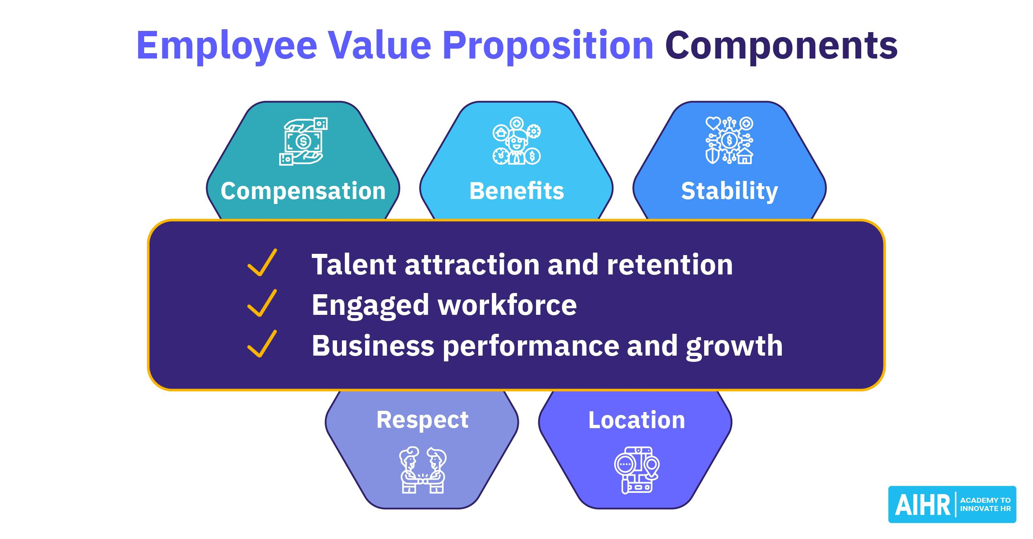
OUR SOLUTION AND ITS VALUE PROPOSITION
• A strong Employee Value Proposition does more than attract and keep talent—it's a motivational force
position (EVP) is a statement of benefits that an organization offers to attract, retain, and engage employees

Slide 8
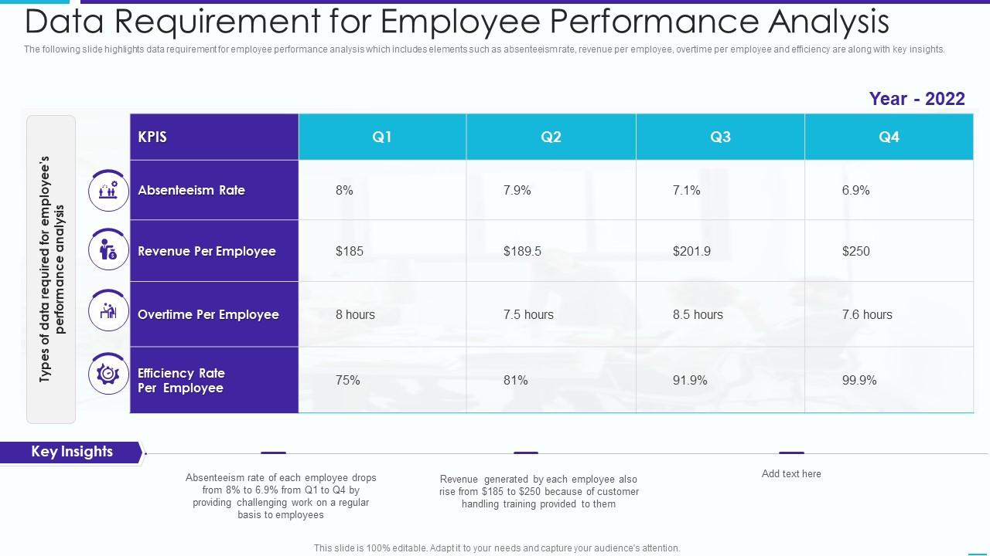
Dataset Description

Slide 9

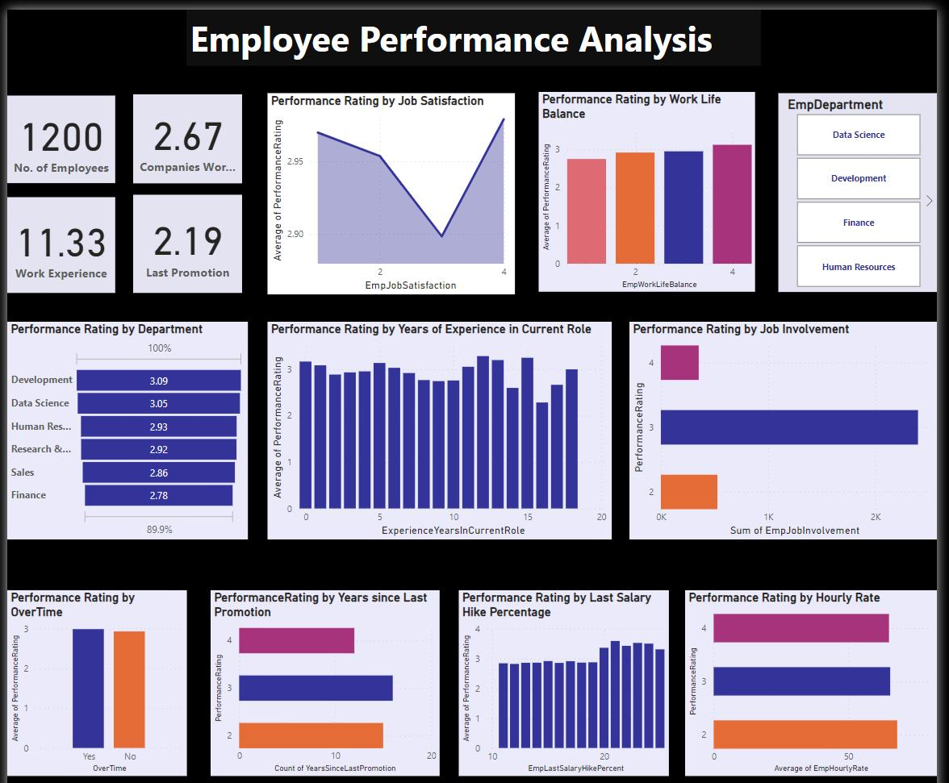
THE "WOW" IN OUR SOLUTION
Employee evaluation software is a tool that helps organizations track, measure, and assess employee performance. HR professionals use it to conduct employee performance reviews and streamline performance evaluation workflows such as collecting 360-degree feedback from other stakeholders and preparing analytics.
3/21/2024 Annual Review
9

Slide 10
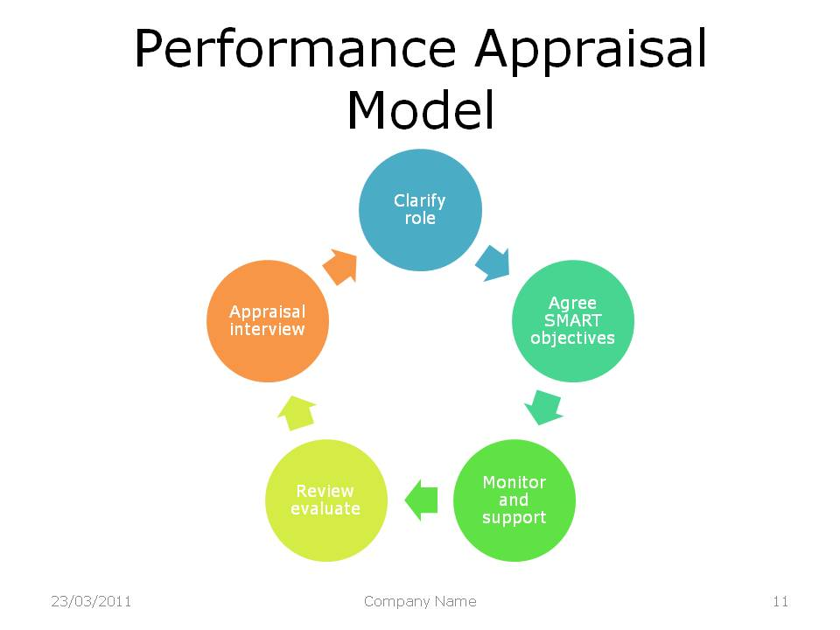
MODELLING
Identifying Performance Drivers
Benchmarking Performance Metrics
Predictive Modeling for Performance Forecasting
Informing Performance Improvement Strategies
planning, monitoring, reviewing and rewarding
10

Slide 11
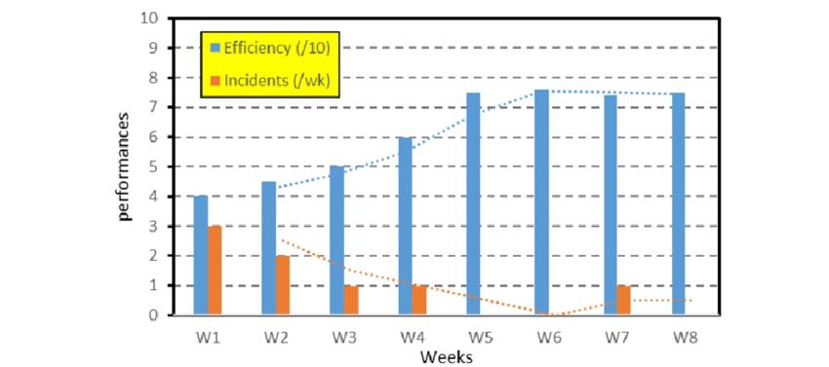
RESULTS
Typically, at least a portion of an employee's performance evaluation includes a review of outcome metrics or progress against previously identified goals . In the corporate sector, for example, part of an employee's performance evaluation might include a review of sales generated or company growth targets
11

Slide 12
conclusion
We can conclude that the company should provide a better environment as it increases the performance drastically
• briefly summarize a person's performance during the review period, highlighting their key strengths and something they can improve upon:

